Slide 1




GIF Lamp

Slide 2
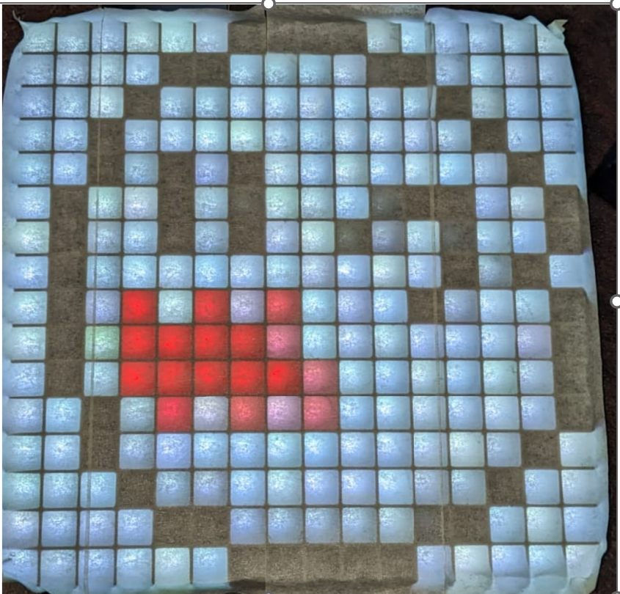
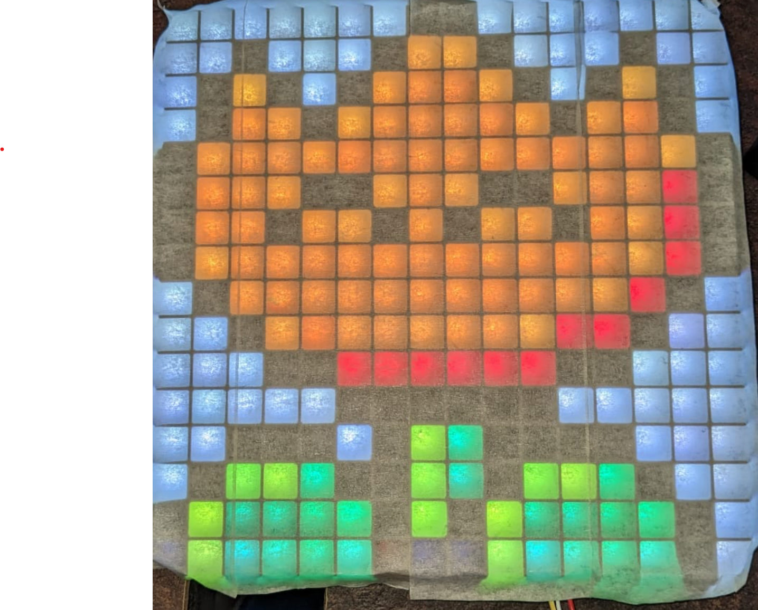
What is gif lamp?
Gif lamp is an interactive smart led board that is fully controlled and customizable with an app on your computer or phone.

Slide 3
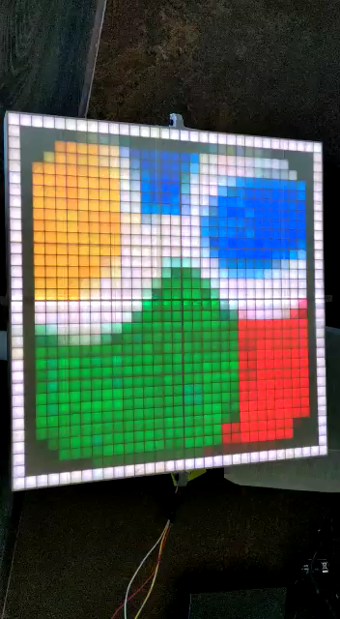
Demonstration

Slide 4
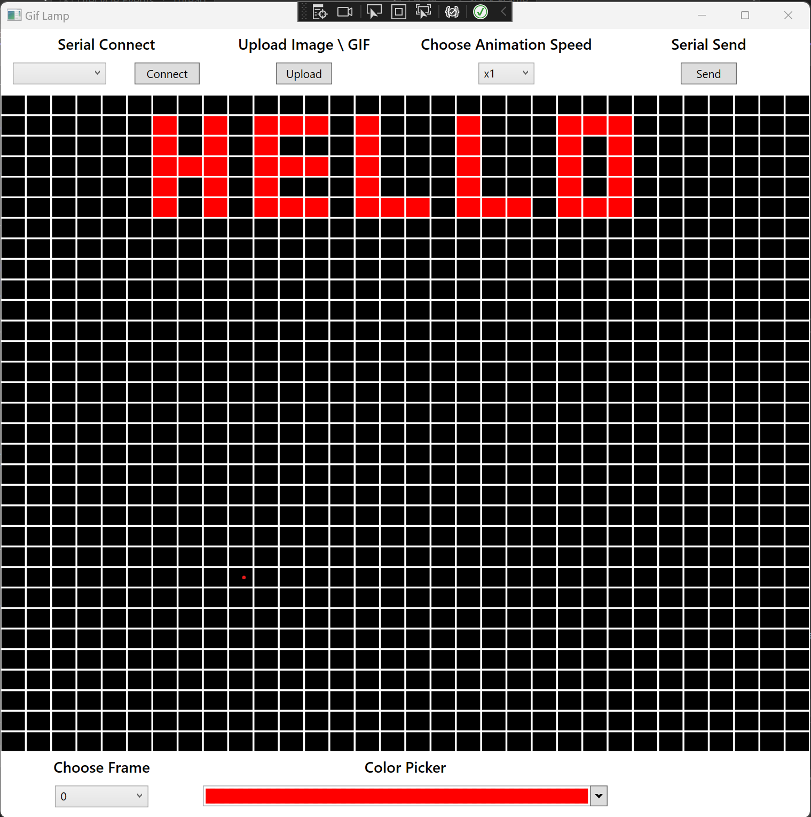
WPF Application
Serial (UART) connection to the led display.
Upload any gif / image that you desire to display on the matrix (live)
Ability to change the animation speed (live)
Pixel art, draw any picture or animation to your desire and watch it go live on the screen
Notes:
When conducting research, it is easy to go to one source: Wikipedia. However, you need to include a variety of sources in your research. Consider the following sources:
Who can I interview to get more information on the topic?
Is the topic current and will it be relevant to my audience?
What articles, blogs, and magazines may have something related to my topic?
Is there a YouTube video on the topic? If so, what is it about?
What images can I find related to the topic?

Slide 5

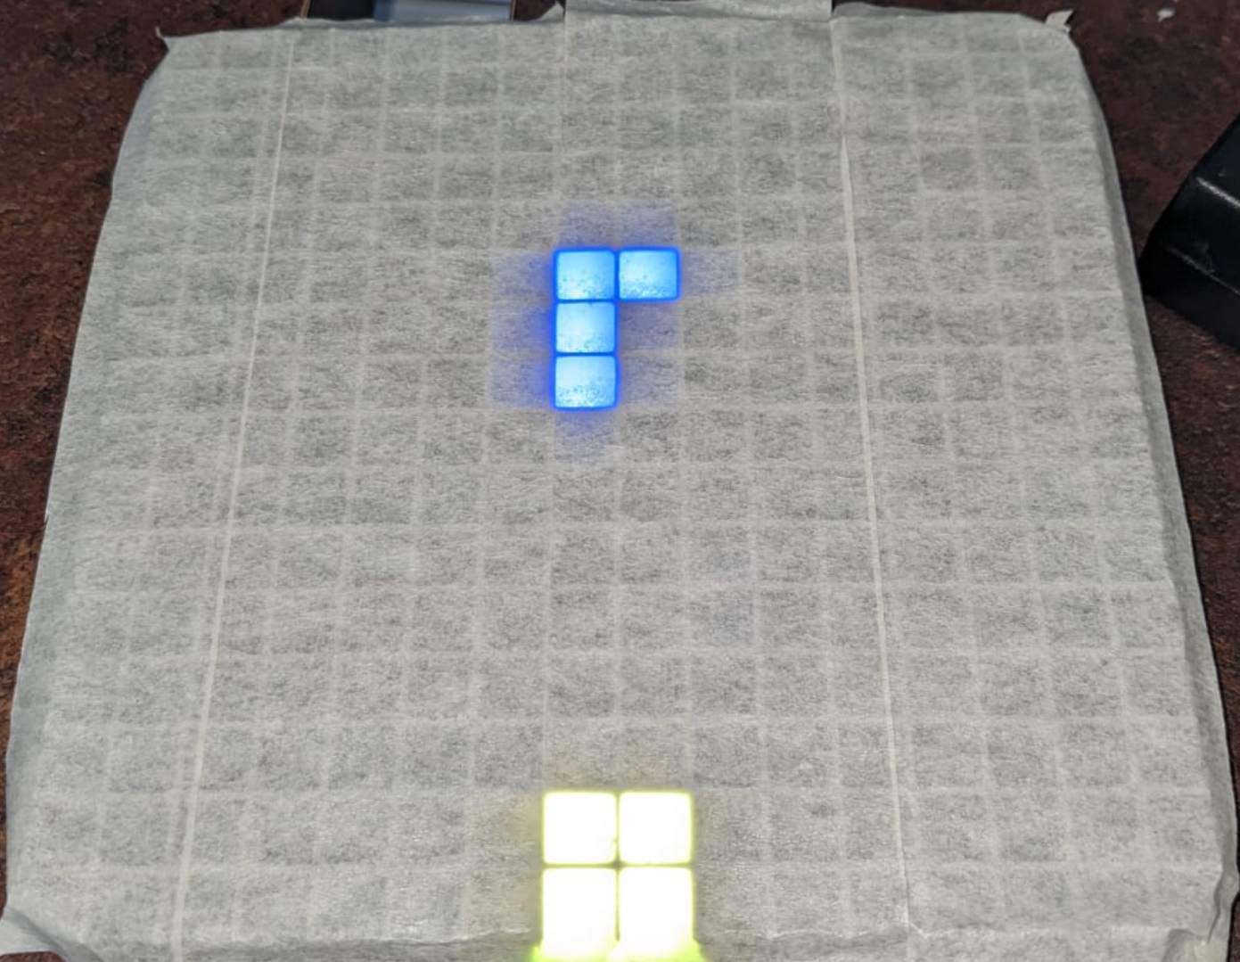
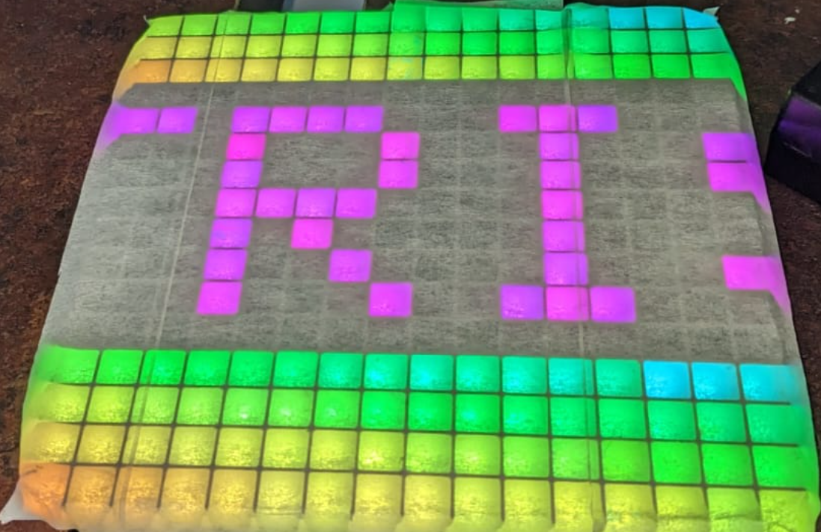
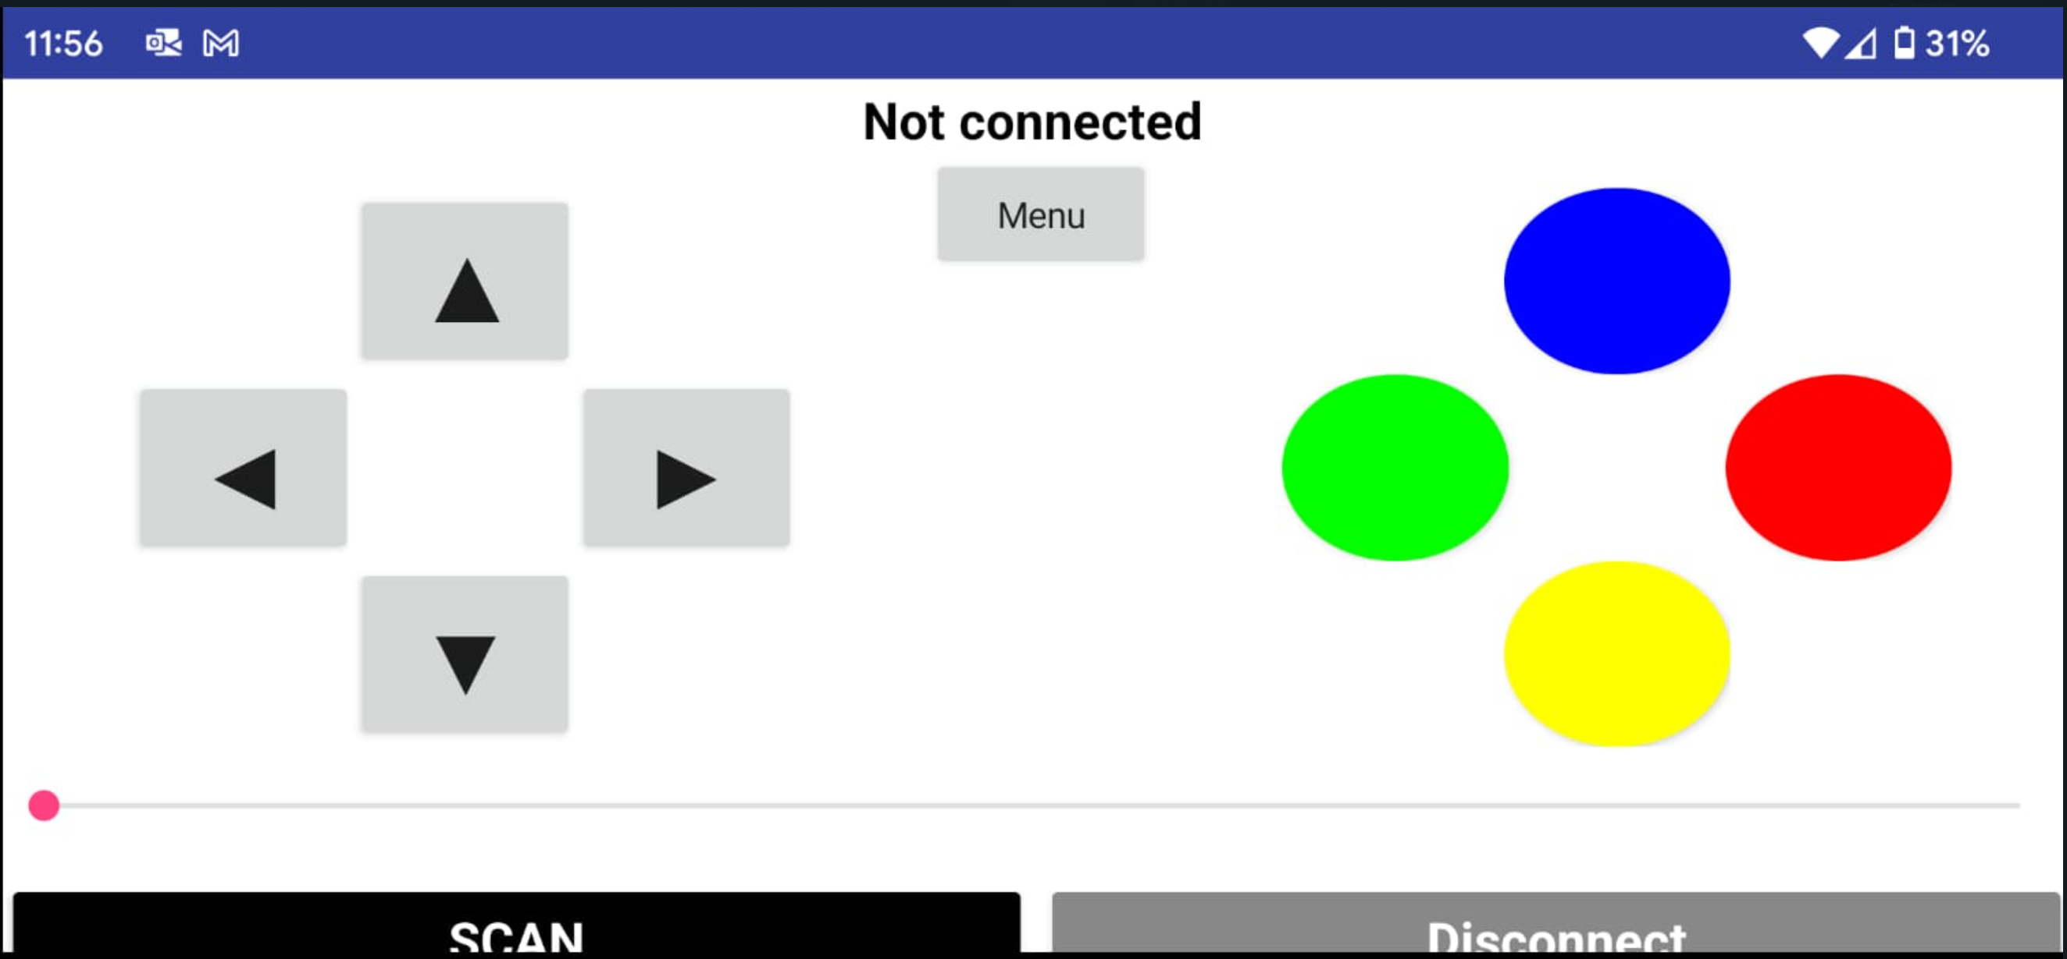
Phone app
Bluetooth connection to the led display.
Play nostalgic games like Snake and Tetris via the app UI
Display constant relaxing animation loop
Notes:
When conducting research, it is easy to go to one source: Wikipedia. However, you need to include a variety of sources in your research. Consider the following sources:
Who can I interview to get more information on the topic?
Is the topic current and will it be relevant to my audience?
What articles, blogs, and magazines may have something related to my topic?
Is there a YouTube video on the topic? If so, what is it about?
What images can I find related to the topic?

Slide 6

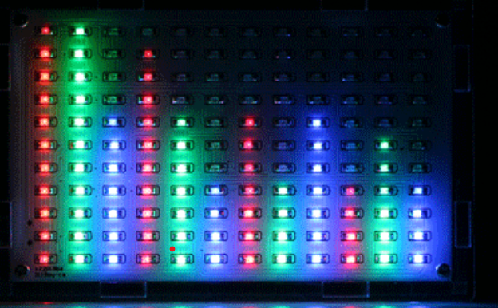

Soundtrack
Not yet implemented, might not be included in final product
Display animations in accordance to outside source of music
Speech to gif – say any word you’d like and watch a gif which is related to said word
Notes:
When conducting research, it is easy to go to one source: Wikipedia. However, you need to include a variety of sources in your research. Consider the following sources:
Who can I interview to get more information on the topic?
Is the topic current and will it be relevant to my audience?
What articles, blogs, and magazines may have something related to my topic?
Is there a YouTube video on the topic? If so, what is it about?
What images can I find related to the topic?

Slide 7

Technical accomplishments
1
Displaying images / gifs which aren’t the size of the matrix – we had to write an algorithm that calculates the correct position of each led light.
2
Resizing gifs and images – we had to write an algorithm to resize the gifs / images while trying to keep the image as clear as possibe
3
Integration between application and hardware (16x16) – we had some issues but we created an header for each message which allowed us to control the led matrix via the application.

Slide 8
Challenges and risks
1
Lack of memory – what happens if the gif we are trying to send is too large for amount of memory left on the ESP?
1
– Tidy up the code (optimization( and remove includes
– Split the gif into multiple frames before sending it
2
32x32 Integration, stuff will not be as compatible and work as well as it did in 16x16
2
– We’ll have to rewrite a lot of code, so the risk is simply lack of time

Slide 9
Thank you!
Notes:
You can use this slide as your opening or closing slide. Should you choose to use it as a closing, make sure you review the main points of your presentation. One creative way to do that is by adding animations to the various graphics on a slide. This slide has 4 different graphics, and, when you view the slideshow, you will see that you can click to reveal the next graphic. Similarly, as you review the main topics in your presentation, you may want each point to show up when you are addressing that topic.
Add animation to images and graphics:
Select your image or graphic.
Click on the Animations tab.
Choose from the options. The animation for this slide is “Split”. The drop-down menu in the Animation section gives even more animations you can use.
If you have multiple graphics or images, you will see a number appear next to it that notes the order of the animations.
Note: You will want to choose the animations carefully. You do not want to make your audience dizzy from your presentation.

